Slide 1
Pitcher Arm Injuries

Slide 2
172 pitchers on Injured List
8,452 Days Missed
$193 Million

Slide 3
Year | Avg FB Velocity | MLB Tommy John Surgeries
2015 | 93.1 mph | 26
2016 | 93.4 mph | 24
2017 | 93.4 mph | 30
2018 | 93.5 mph | 30
2019 | 93.6 mph | 32
2020 | 93.3 mph | 15 (COVID 60-game season)
2021 | 93.7 mph | 32
2022 | 93.9 mph | 28
2023 | 94.2 mph | 31
2024 | 93.3 mph | 33

Slide 4
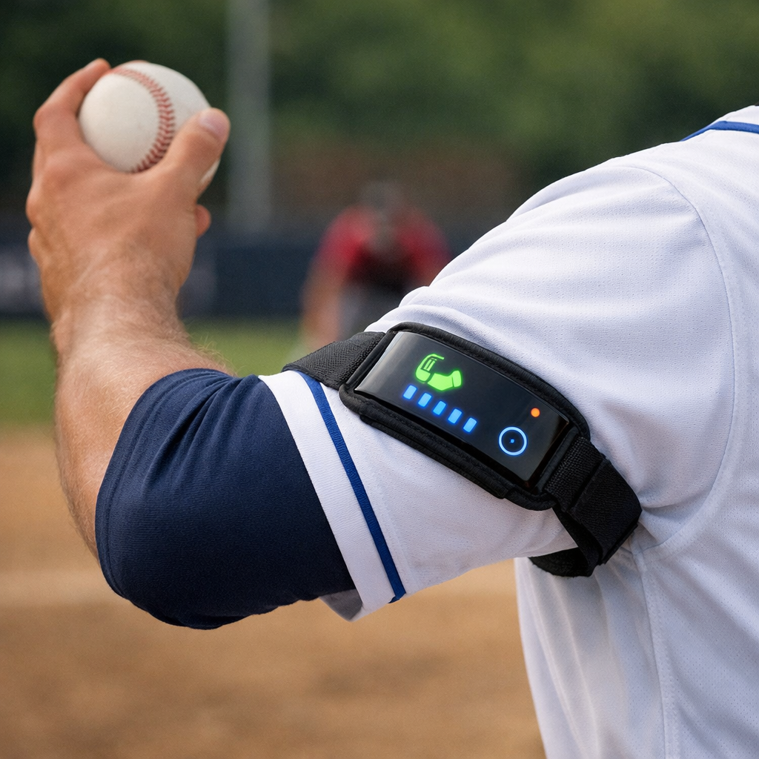

Slide 5
What it does
Helps identify what causes injuries.
Why it causes the injury.
Sends data

